Slide 1
301, Nov 3, Class 21
Non-Experimental designs
Example publication: Plant et al. (2009)
  The Obama Effect

Slide 2
Non-experimental designs
Collected in the real world outside the laboratory
  Observation
  Surveys
  Qualitative research
  Intervention research
Lack of control = less internal validity
  As little as none in some cases
Collecting data in context = greater external validity
  Little concern about applying outside the lab

Slide 3
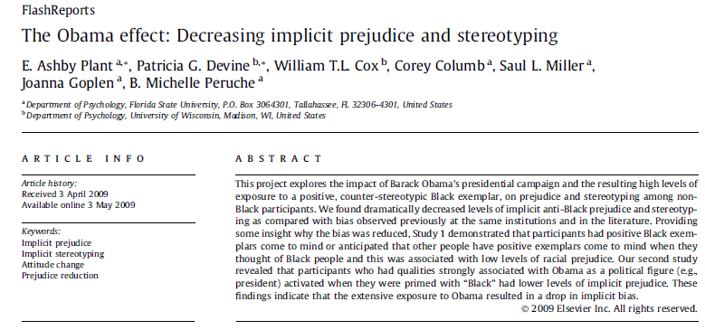

Slide 4
Evaluative IAT. The IAT is a dual categorization task in which participants categorize words as pleasant or unpleasant and faces as either Black or White by pressing one of two keys on the computer keyboard. Stimuli consisted of pleasant and unpleasant words as used by Greenwald et al. (1998) and pictures of White and Black male faces displaying neutral expressions (Malpass, Lavigueur, & Weldon, 1973) as used by Devine, Plant, Amodio, Harmon-Jones, and Vance (2002; Study 3). Pleasant words included honor, lucky, diamond, loyal, freedom, rainbow, love, honest, peace, and heaven. Unpleasant words included evil, cancer, sickness, disaster, poverty, vomit, bomb, rotten, abuse, and murder

Slide 5
IAT
Block 1: Is this word good or bad?
Block 2: Is this face black or white?
Blocks 3-4: Mixed together, compatible with bias
  Same hand for good/white, bad/black
Block 5: Mixed, incompatible with bias
DV = RT on block 5 – average on 3 & 4

Slide 6
IAT Design
Aimed at overcoming response bias inherent in asking about racial stereotype/attitudes
  Surveys can produce inaccurate data
Demonstrates the concept of ‘implicit’ elements of cognition
  Unintentional bias
DV is fairly noisy
  Can exhibit poor test-retest reliability

Slide 7
Non-experimental research
“The goal of this project was to explore whether Obama’s historic presidential campaign and the resulting high levels of exposure to a positive, counter-stereotypic Black exemplar led to reduced racial prejudice and stereotyping.”
Q1. Can we be confident about the causal direction here? Why or why not?
Q2. Give an alternate interpretation of the data. The interpretation must be with the data as observed (not an alternate outcome) but is a different inference.

Slide 8
Additional questions
Why could this research only be done non-experimentally?
If the authors interpretation of the effect is correct, what subsequent recent historic events might we see as having similar types of effects and what might these be?
What principle of survey question design is implicit in the procedure of the IAT?

Slide 9

Causation and Correlation
Non-experimental design identifies correlations among variables measured in the real world

Slide 10
Causality
If variables X & Y are very strongly correlated, does X cause Y?
Correlation between X & Y means either
  X causes Y
  Y causes X
  Z causes both X and Y

Slide 11
Variables observed to co-vary
  Hot weather is associated with higher rates of street violence
  Older people exercise less than middle aged people
  A college education increases people’s SAT scores

Slide 12
Intervention research in child development has repeatedly produced a paradoxical conclusion: In correlational studies, parental assistance with children’s homework has been associated with lower academic achievement. As a result, some psychologists have concluded in published reports that parents should not help their children with homework…

Slide 13
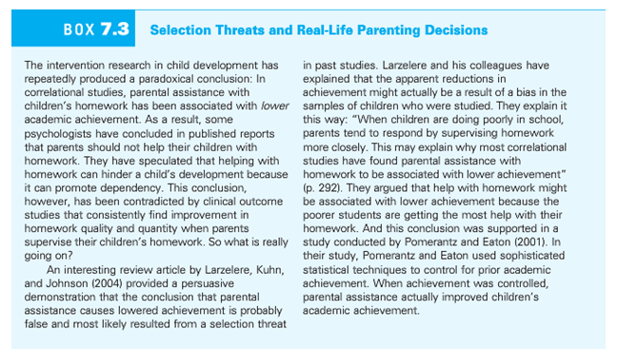

Slide 14
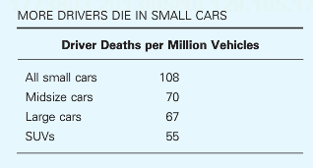
Multiple accounts consistent with the data
Large cars are safer than small cars
  Small cars are more dangerous than large cars
Safest cars: Acura RX SUV, Acura RL sedan, Audi 4
Most dangerous cars: Chevy Cobalt, Ford Focus, Mazda 3

Slide 15
Validity
Q1. Why are experimental studies higher in internal validity?
Q2. Why are nonexperimental studies higher in external validity?

Slide 16
Correlations
For each of the following statistical relationships, decide whether the directionality problem is present and think of at least one plausible third variable.
  People who eat more lobster tend to live longer.
  People who exercise more tend to weigh less.
  College students who drink more alcohol tend to have poorer grades.

Slide 17
Famous Non-experimental Psychology Studies
Stanley Milgram found that about two thirds of his research participants were willing to administer dangerous shocks to another person just because they were told to by an authority figure (Milgram, 1963).
Elizabeth Loftus and Jacqueline Pickrell showed that it is relatively easy to “implant” false memories in people by repeatedly asking them about childhood events that did not actually happen to them (Loftus & Pickrell, 1995).

Slide 18
For Wed, 11/5
Read Chapter 13
  Case Studies, Developmental methods, and (some) History of Psychology
  Questions on Canvas
Working on Final Projects
  Updating initial ideas
  Building a full proposal (new Announcement/thread on Group Homepage)

